Slide 1

DEEP LEARNING BASED POTHOLE DETECTION SYSTEM
Under the guidance of
Ms. Deepa D,
by
Rahul Roonwal
(39110825)
Rajeev Nayan
(39110828)

Slide 2
Presentation Outline
Introduction
Experimental Setup
Dataset Used
Algorithms Applied
Results Obtained - CNN
Results Obtained – YOLO v5
Screenshots
Existing Algorithm – Comparison

Slide 3
Introduction
The proposed project solves the problem of pothole detection using various deep learning techniques.
It compares various deep learning models to find the best technique for predicting the damaged roads.
Algorithm with maximum accuracy is used for further implementation.

Slide 4
Experimental Setup
In order to do this project, we are using a Computer System with a RAM of 8GB for faster processing and various other softwares as well.
The various softwares used are Juypter Notebook, Google Colab and VS code.

Slide 5
Datasets Used
For YOLO v5 algorithm, the dataset is imported from the Roboflow website. It is a website which provides datasets in different format options.
For the CNN algorithm used, the dataset is downloaded from the Kaggle website. In this dataset, there are plain images as well as images with potholes.

Slide 6
Algorithms Applied
To predict the potholes, various algorithms are used and the algorithm with the highest accuracy is found out.
The various algorithms used are CNN and YOLO v5 and by implementing both these algorithms, the model with the highest accuracy is found out.

Slide 7
Results Obtained - CNN
In CNN, the dataset used was containing a total of 960 images, 486 – plain images and 474 – pothole images.
Here, 768 images were passed for training and the remaining 192 images were used for testing.
The accuracy obtained using CNN model was 93.34%

Slide 8
Results Obtained – YOLO v5
In CNN, the dataset used was imported from the Roboflow website.
Here, a total of 465 images were used for training and the training was done on different epochs and batch sizes.
The epoch value with the best accuracy was taken into consideration.
The accuracy obtained using this model was 73.34%

Slide 9
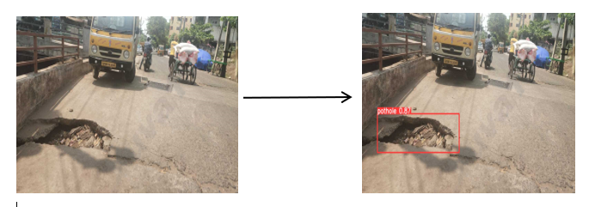
Screenshots
In the below image, the pothole is found out using the Yolo v5 algorithm.

Slide 10
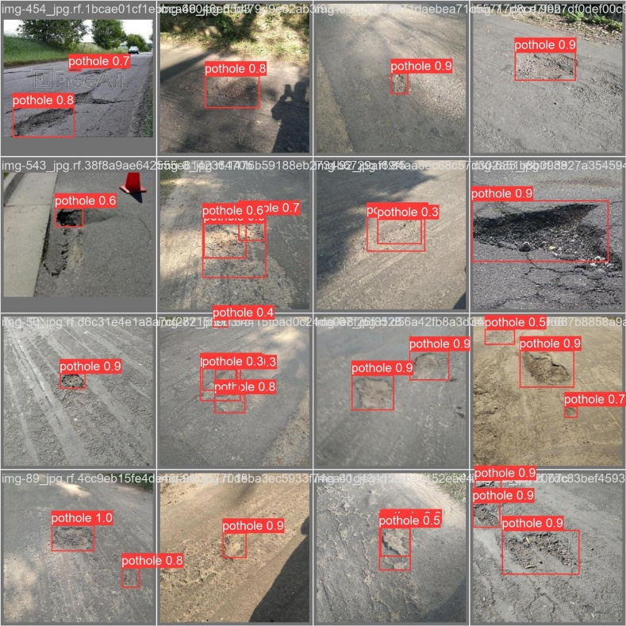
Screenshots
In the below image, the pothole is found out using the various algorithms.

Slide 11
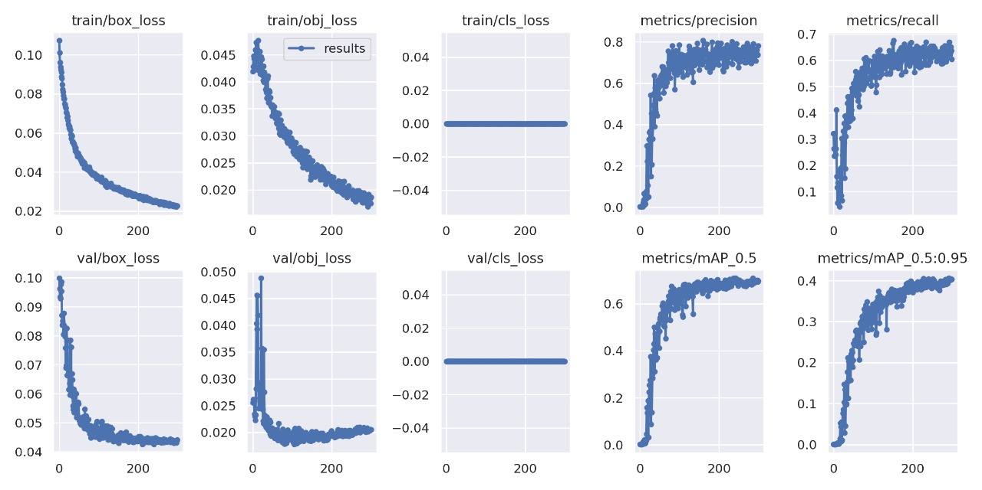
Screenshots

Slide 12
Existing Algorithm – Comparison
In our algorithm, we trying to increasing the accuracy by training the model using a large dataset.
Also, we are using various algorithms to train our model such as CNN, YOLO v5, etc.
The algorithm with the highest accuracy is used further.

Slide 13
THANK YOU
We thank our guide and panel and all technical and non technical staff helped us in achieving this.

